Slide 1

Automated Meeting Room Booking System
By:
Vamsi Kandula
Kamalakar
Kushal Rathi
Ankita Kiran
Porush Verma
Rahul Rudra
Khushi
Kavya

Slide 2


Front-end Overview
The Frontend offers an intuitive interface tailored for different roles—Admin, Manager, and Employee—ensuring seamless interactions.
1. Login Interface
Common login screen for all roles: Admin, Manager, Employee.
Fields: Username, Password (masked).
Validation: Both fields required; error message if credentials are incorrect.
Redirects to role-specific dashboards.
2. Admin Dashboard
Admin Functionalities:
View All Users: Displays user details in a table
Add Users: Form to add new users
Check Room Status: Calendar view for room availability, displaying booked/free slots.
Manage Room Requests: Review, approve/reject pending requests from Managers.
Alter Meeting Rooms: Add, update, or delete rooms (Name, Capacity, Amenities).

Slide 3
.
3. Manager Dashboard
Manager Functionalities:
Raise Meeting Requests: Form with fields like Title, Room, Date, Time, Meeting Type (predefined amenities auto-selected).
Add Users to Meetings: Multi-select dropdown to assign attendees.
View Meeting Schedule: Calendar and list views with filters for request statuses.
4. Employee Dashboard
Employee Functionalities:
View Assigned Meetings: List of all scheduled meetings with details (Title, Date, Time, Room, Status).

Slide 4


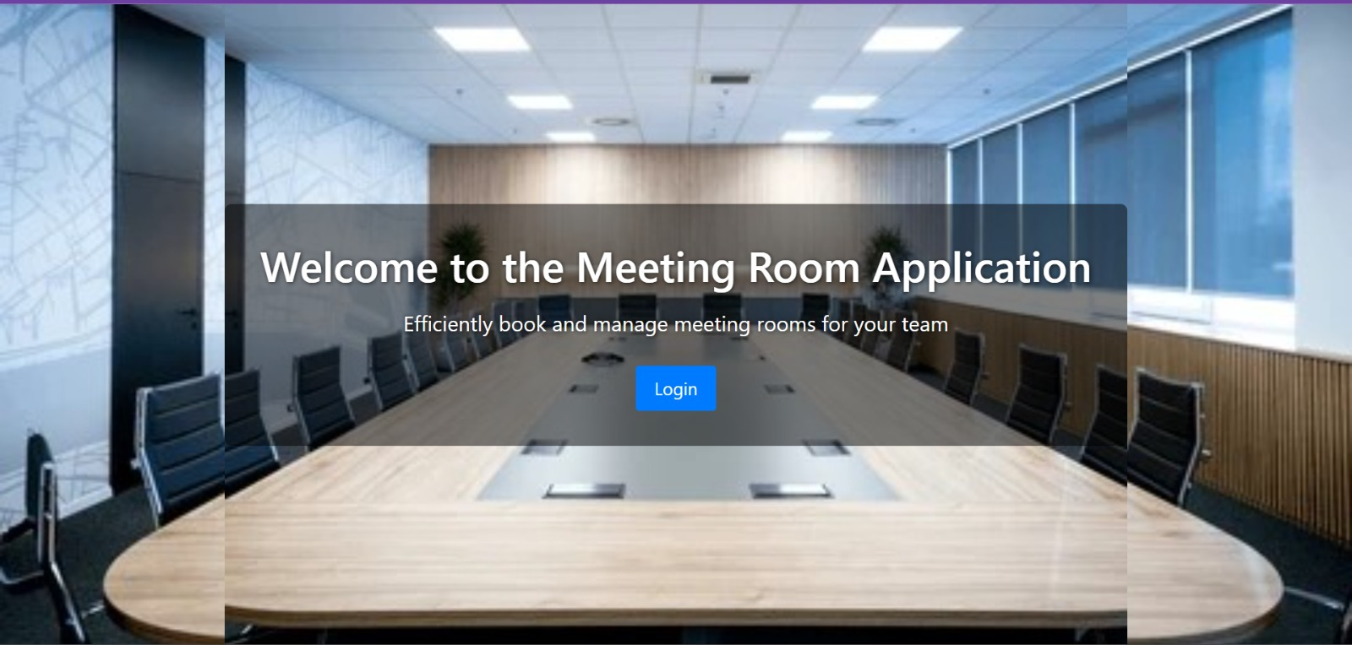

Slide 5
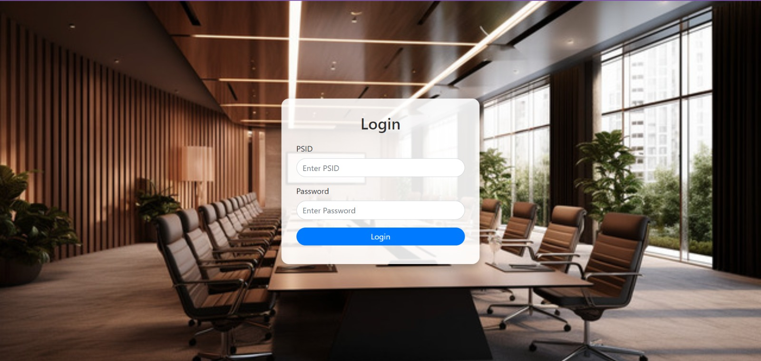

Slide 6
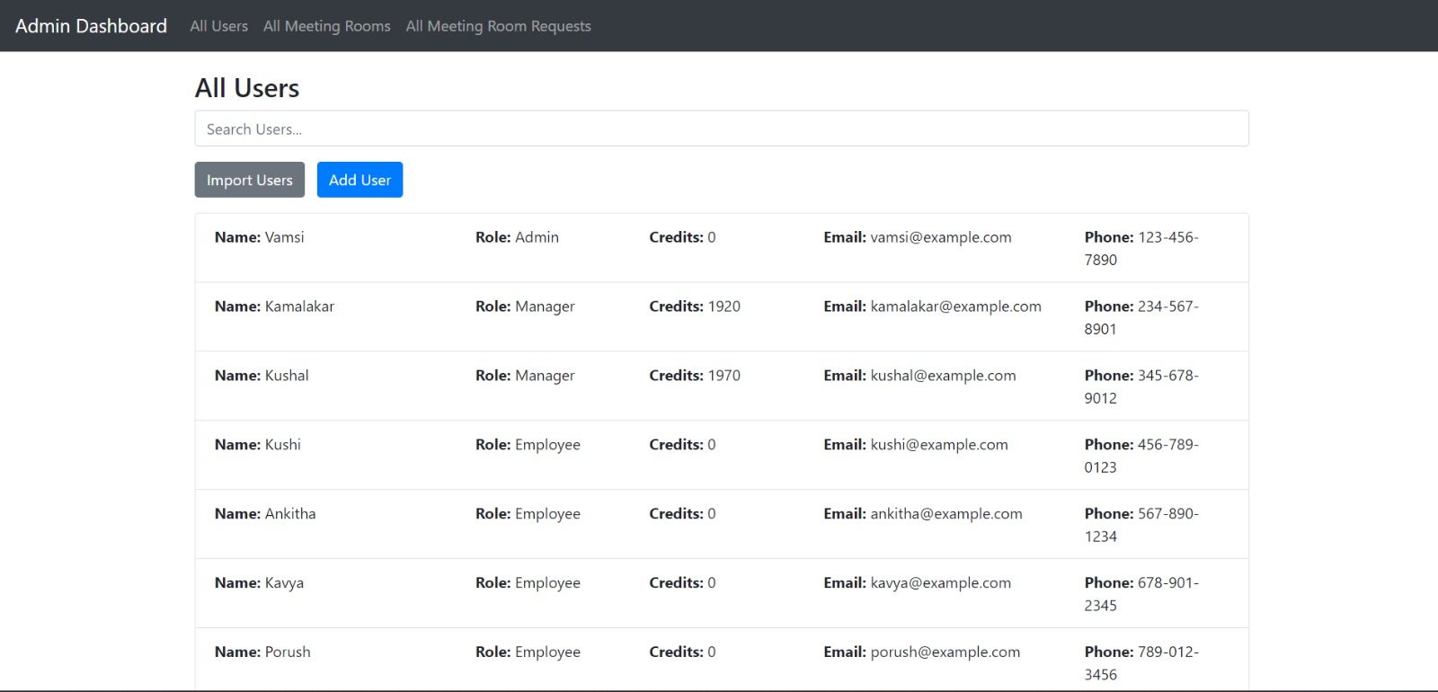

Slide 7
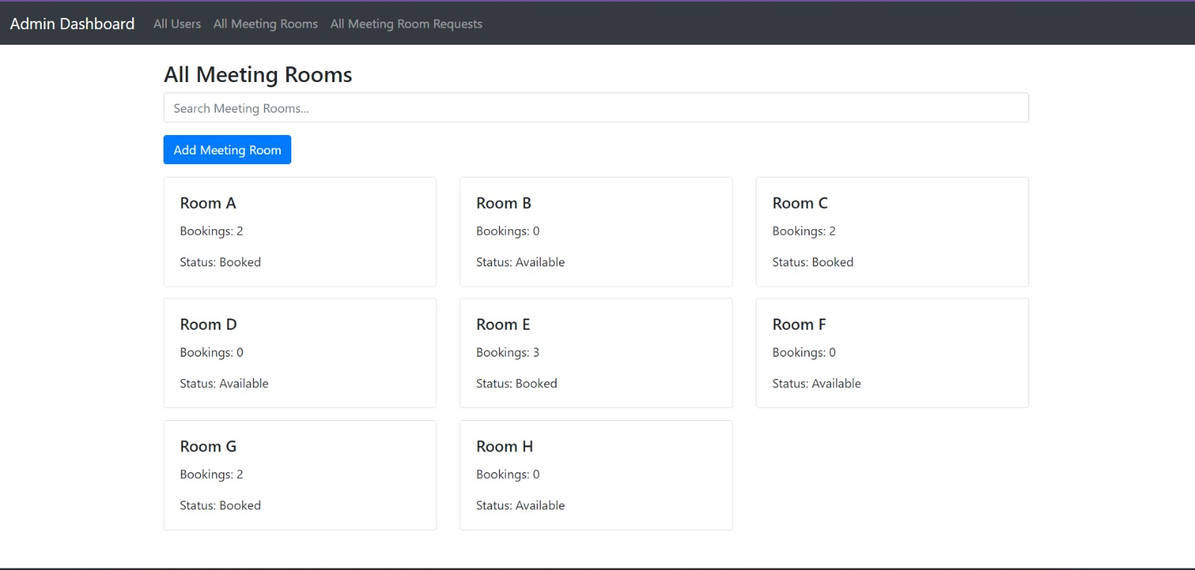

Slide 8
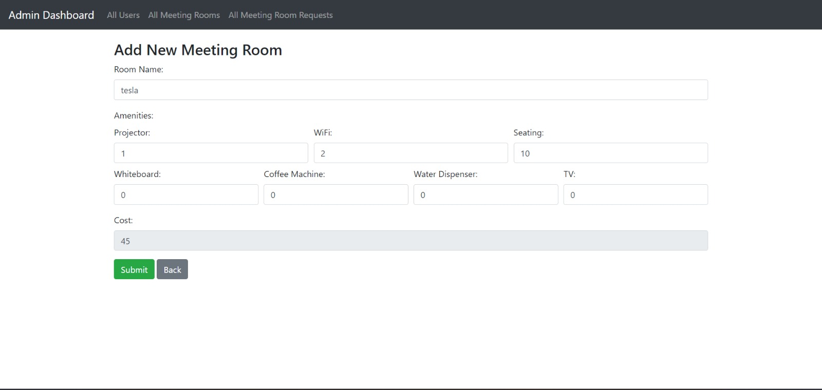

Slide 9
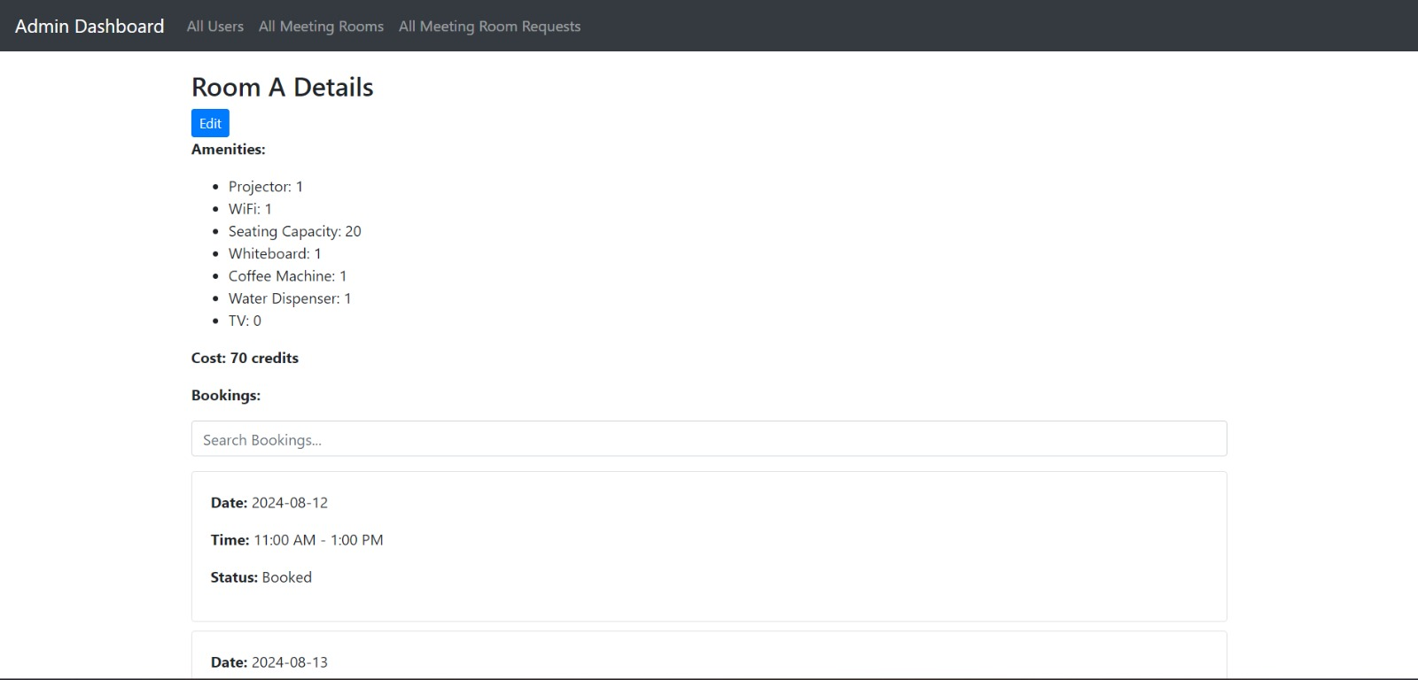

Slide 10
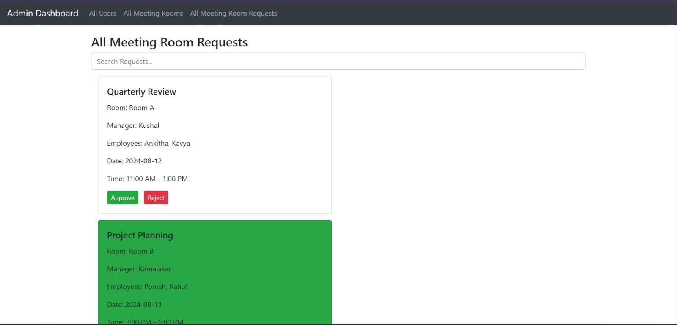

Slide 11
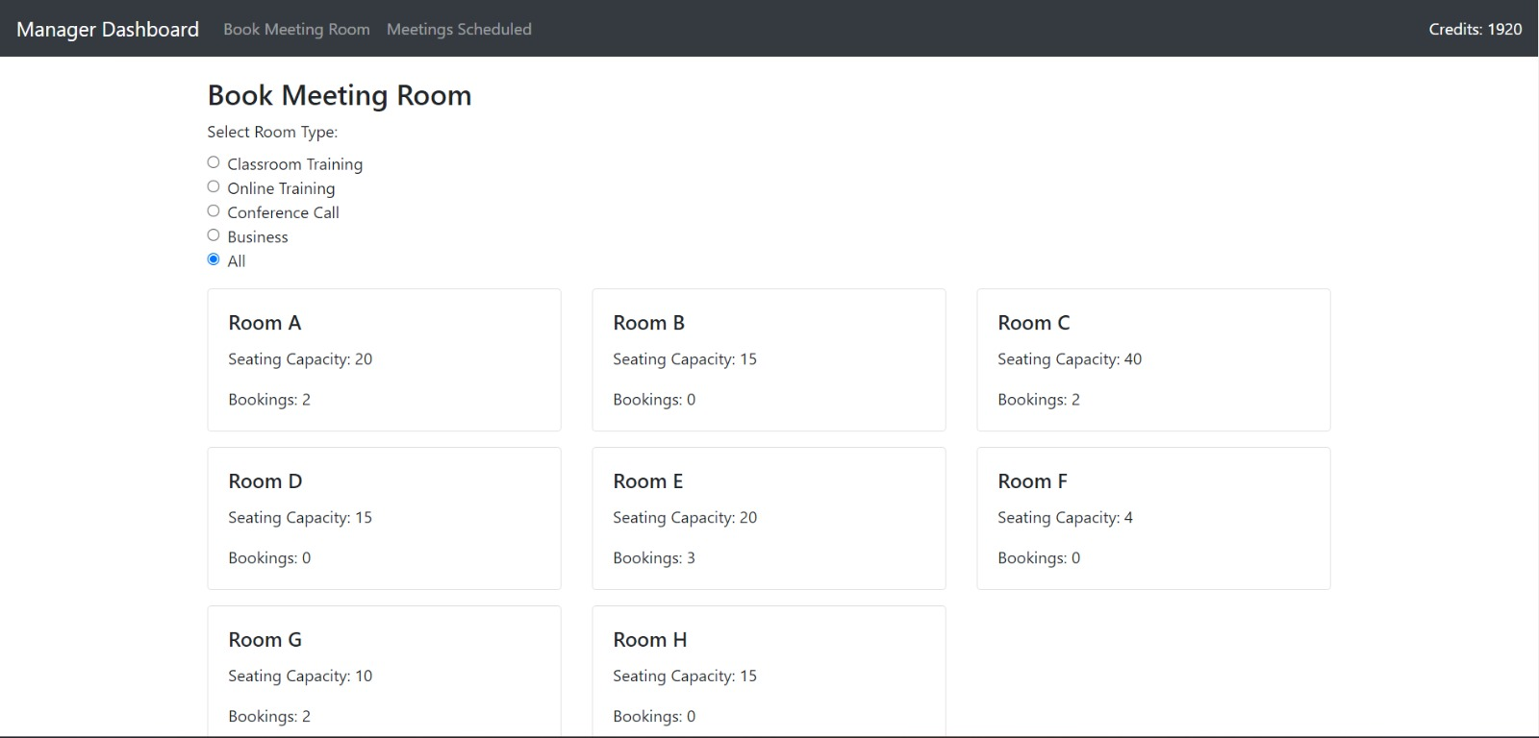

Slide 12
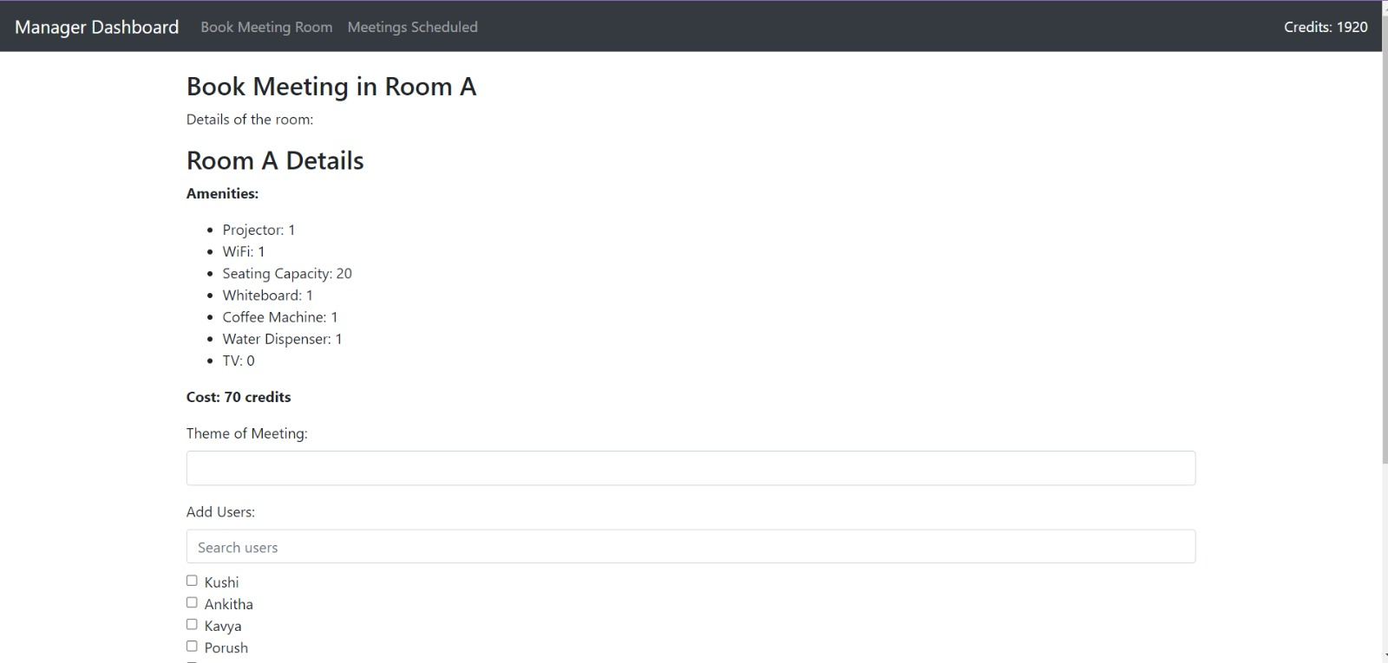

Slide 13
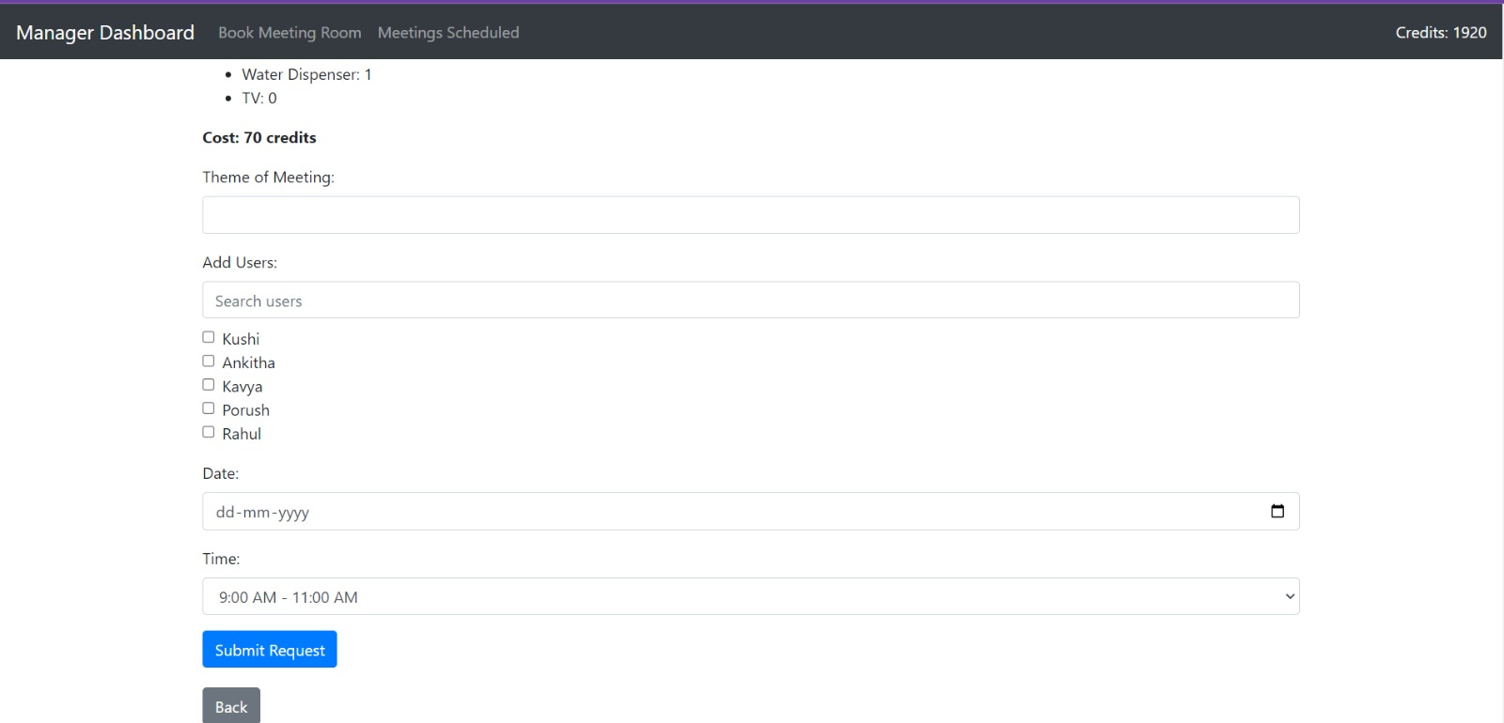

Slide 14
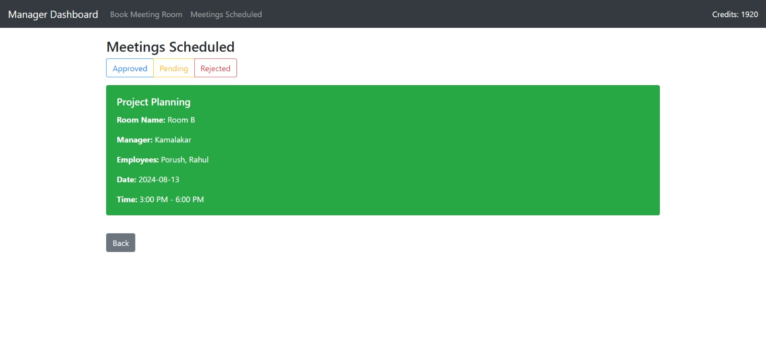

Slide 15
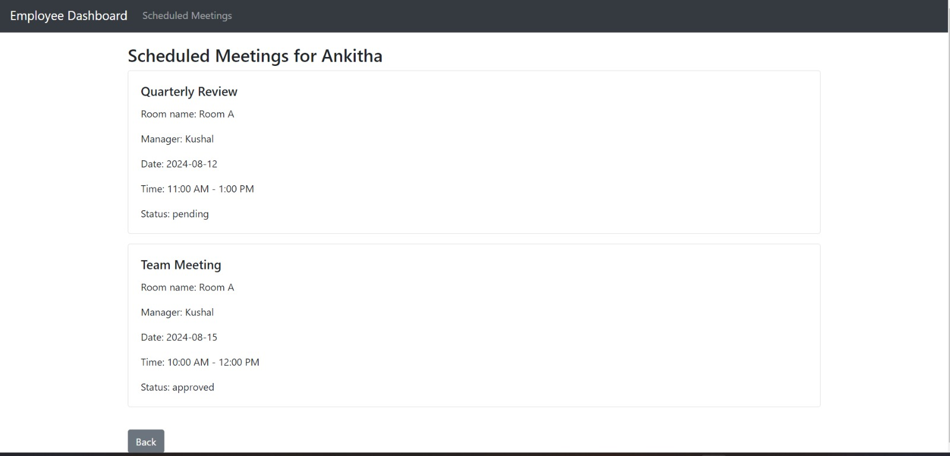

Slide 16
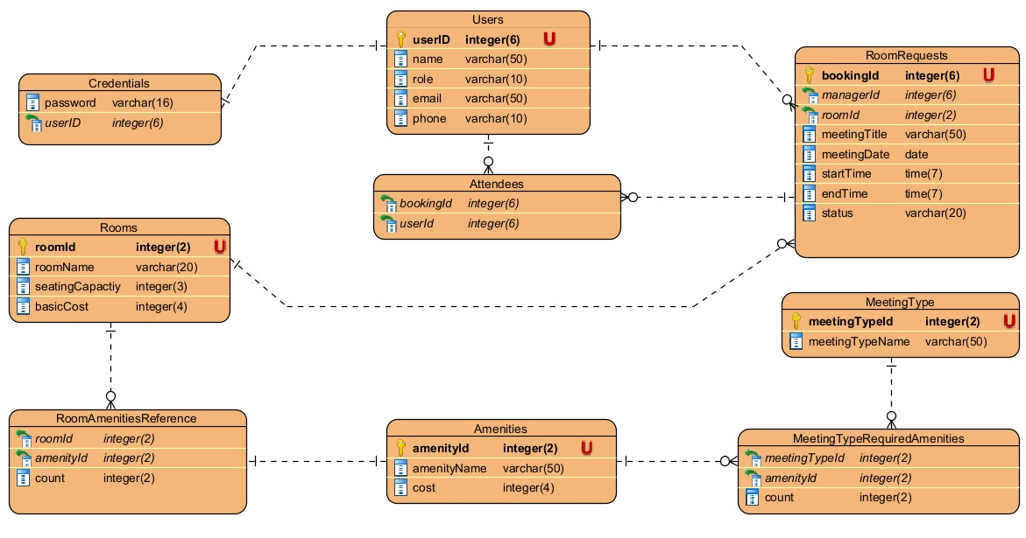
Database Schema Overview

Slide 17
Various Tables :
1. Users
userID (PK): Unique identifier for users.
Name, Role, email, phone: User details including role (Admin, Manager, Member).
Role: Central to managing users and their activities.
2. Credentials
userID (FK): Links to Users.
password: Stores user passwords.
3. RoomRequests
bookingId (PK): Unique booking identifier.
managerId, roomId (FK): Links to Users and Rooms.
meetingTitle, date, startTime, endTime: Meeting details.
status: Tracks booking status (e.g., pending, approved).

Slide 18
4. Attendees
bookingId, userId (Composite PK): Links users to bookings (many-to-many).
5. Rooms
roomId (PK): Unique room identifier.
roomName, seatingCapacity, basicCost: Room details.
6. Amenities
amenityId (PK): Unique amenity identifier.
amenityName, cost: Describes available amenities (e.g., WiFi, Projector).

Slide 19
7. RoomAmenitiesReference
roomId, amenityId (Composite PK): Links rooms to amenities.
count: Number of available amenities in a room.
8. MeetingType
meetingTypeId (PK): Unique meeting type identifier.
meetingTypeName: Meeting type (e.g., Conference, Training).
9. MeetingTypeRequiredAmenities
meetingTypeId, amenityId (Composite PK): Links meeting types to required amenities.
count: Specifies required quantity of amenities.

Slide 20
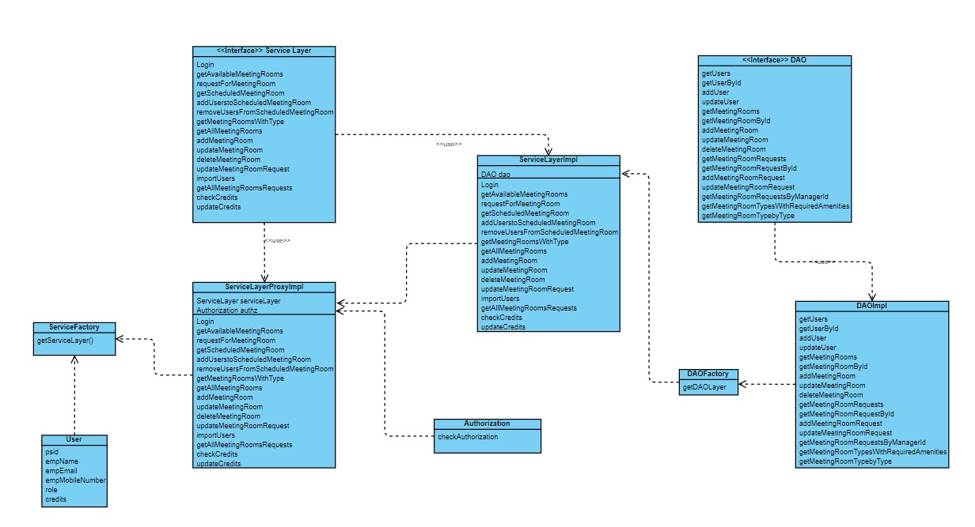
Design Pattern

Slide 21
Design Pattern
Our project leverages several design patterns to enhance modularity and maintainability:
Factory Pattern:
Implemented in the DAO and Service layers.
This pattern ensures that object creation is centralized, making it easier to manage dependencies and promote loose coupling.
Proxy Pattern:
Applied between the UI and Service layers.
When the UI layer requests access to the Service layer, a Service Proxy handles authorization and authentication.
Only after successful verification is the actual Service object returned, enhancing security and control over access.

Slide 22

THANK YOU

